Slide 1
Algorithm Explanation
Walid Babi

Slide 2
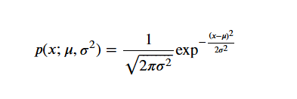
Gaussian Anomaly Detection Algorithm
This approach uses the Gaussian (Normal) Distribution to identify anomalies in a continuous data stream.

Slide 3
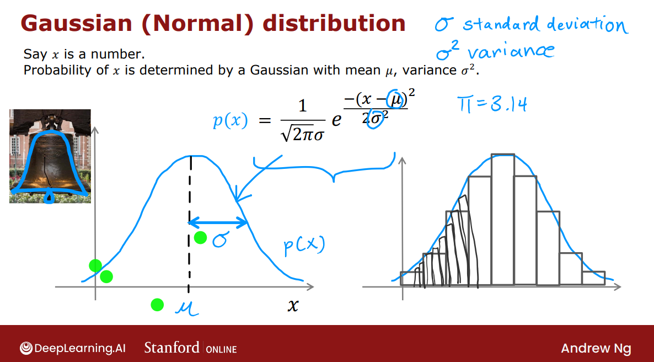

Slide 4
Why Choose this Algorithm
Unlabeled Data
This means we don't have pre-labeled data indicating whether a point is normal or anomalous.
Unsupervised Learning
focuses on finding patterns and insights in data without pre-labeled outcomes.
Compute PDF Value
The probability density function (PDF) value is calculated for the current data point based on the mean and standard deviation of the window.
Threshold Check
If the PDF value is below a predefined threshold, the data point is flagged as an anomaly.

Slide 5
SUMMARY
This method is effective in detecting anomalies that deviate significantly from the normal distribution of the data points in the window. By adjusting the threshold, we can control the sensitivity of the anomaly detection, balancing between detecting true anomalies and minimizing false positives.

Slide 6
THANK YOU
Walid Babi
055 460 2500
walid.babi.du@gmail.com
www.linkedin.com/in/walidbabi

